Slide 1
Linux Commands

Slide 2
Unix
UNIX is a computer Operating System which is capable of handling activities from multiple users at the same time.
Unix was originated around in 1969 at AT&T Bell Labs by Ken Thompson and Dennis Ritchie.

Slide 3
Unix . . .
Several people can use a UNIX computer at the same time; hence UNIX is called a multiuser system.
A user can also run multiple programs at the same time; hence UNIX is called multitasking.
There are various Unix variants available in the market. Solaris Unix, AIX, HP Unix and BSD are few examples. Linux is also a flavor of Unix which is freely available.

Slide 4
Linux
Linux is one of popular version of UNIX operating System. It is open source as its source code is freely available. It is free to use. Linux was designed considering UNIX compatibility. It's functionality list is quite similar to that of UNIX.

Slide 5
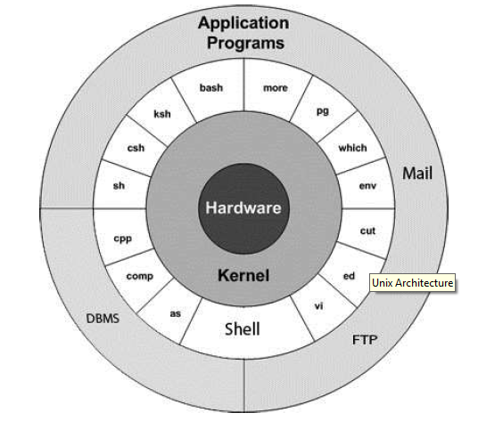

Slide 6
Kernel: The kernel is the heart of the operating system. It interacts with hardware and most of the tasks like memory management, task scheduling and file management.
Shell: The shell is the utility that processes your requests. When you type in a command at your terminal, the shell interprets the command and calls the program that you want. The shell uses standard syntax for all commands. C Shell, Bourne Shell and Korn Shell are most famous shells.

Slide 7
Commands and Utilities: There are various command and utilities which you would use in your day to day activities like cp, mv, cat etc.
Files and Directories: All data in UNIX is organized into files. All files are organized into directories. These directories are organized into a tree-like structure called the filesystem.

Slide 8
COMMANDS

Slide 9
Calendar
To display calendar.
$ cal

Slide 10
Listing Directories and Files
All data in UNIX is organized into files. All files are organized into directories. These directories are organized into a tree-like structure called the filesystem.
You can use ls command to list out all the files or directories available in a directory.
$ ls –l

Slide 11
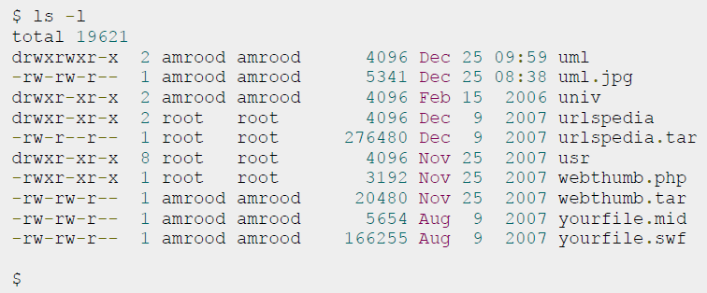

Slide 12
1. First Column: represents file type and permission given on the file. Below is the description of all type of files.
2. Second Column: represents the number of memory blocks taken by the file or directory.
3. Third Column: represents owner of the file. This is the Unix user who created this file.
4. Fourth Column: represents group of the owner.
5. Fifth Column: represents file size in bytes.
6. Sixth Column: represents date and time when this file was created or modified last time.
7. Seventh Column: represents file or directory name.

Slide 13
Who Are You?
While you're logged in to the system, you might be willing to know : Who am I?
$ whoami

Slide 14
Who is Logged In?
Sometime you might be interested to know who is logged in to the computer at the same time.
$ who

Slide 15
FILES

Slide 16
Creating Files
You can use vi editor to create ordinary files on any Unix system
$ vi filename
You would need to press key i to come into edit mode. Once you are in edit mode you can start writing your content in the file.
Press key esc to come out of edit mode.
Press two keys Shift + ZZ together to come out of the file completely.

Slide 17
You can use following keys to move inside a file:
l key to move to the right side.
h key to move to the left side.
k key to move up side in the file.
j key to move down side in the file.

Slide 18
Display Content of a File
You can use cat command to see the content of a file.
$ cat filename

Slide 19
Counting Words in a File
You can use the wc command to get a count of the total number of lines, and words contained in a file.
$ wc filename
2 19 103 filename
$

Slide 20
Copying Files
To make a copy of a file use the cp command.
$ cp source_file destination_file

Slide 21
Renaming Files
To change the name of a file use the mv command.
$ mv old_file new_file

Slide 22
Deleting Files
To delete an existing file use the rm command.
$ rm filename
You can remove multiple files at a tile as follows:
$ rm filename1 filename2 filename3

Slide 23
DIRECTORIES

Slide 24
Home Directory
The directory in which you find yourself when you first login is called your home directory.
You will be doing much of your work in your home directory and subdirectories that you'll be creating to organize your files.
You can go in your home directory anytime using the following command:
$ cd ~
Here ~ indicates home directory.

Slide 25
Creating Directories
Directories are created by the following command:
$mkdir dirname

Slide 26
Removing Directories
Directories can be deleted using the rmdir command as follows:
$rmdir dirname
Note: To remove a directory make sure it is empty which means there should not be any file or sub-directory inside this directory.
$rm -rf dirname

Slide 27
Changing Directories
You can use the cd command to change directory.
$cd dirname

Slide 28
Renaming Directories
The mv command can also be used to rename a directory. The syntax is as follows:
$mv olddir newdir

Slide 29
FILE PERMISSION

Slide 30
File ownership is an important component of LINUX that provides a secure method for storing files.
Every file in UNIX has the following attributes:
Owner permissions: The owner's permissions determine what actions the owner of the file can perform on the file.
Group permissions: The group's permissions determine what actions a user, who is a member of the group that a file belongs to, can perform on the file.
Other (world) permissions: The permissions for others indicate what action all other users can perform on the file.

Slide 31
Changing Permissions
To change file or directory permissions, you use the chmod (change mode) command. There are two ways to use chmod:
symbolic mode
absolute mode.

Slide 32
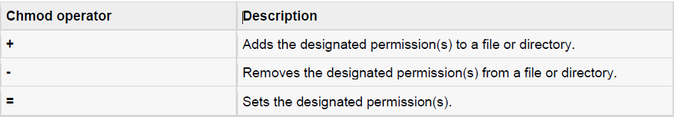
Using chmod in Symbolic Mode
The easiest way for a beginner to modify file or directory permissions is to use the symbolic mode. With symbolic permissions you can add, delete, or specify the permission set you want by using the operators in the following table.

Slide 33

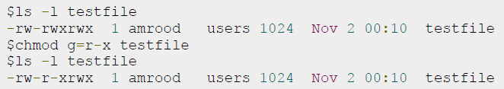
Example

Slide 34
Using chmod with Absolute Permissions
The second way to modify permissions with the chmod command is to use a number to specify each set of permissions for the file.
Each permission is assigned a value

Slide 35
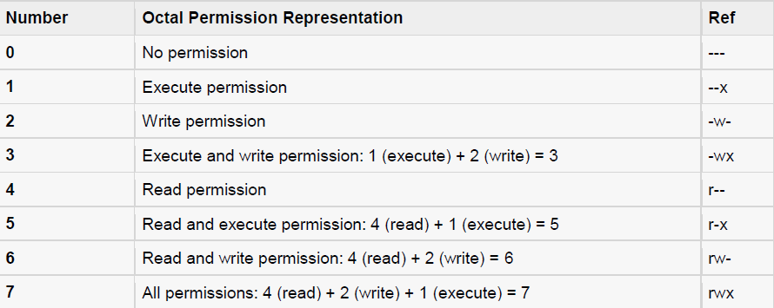

Slide 36
